Slide 1
Computer Vision and Image Processing
Tirgul 16
Epipolar Geometry
By Shai Aharon & Moriya Bitton

Slide 2
Epipolar geometry

Slide 3

Epipolar geometry
When capturing a 3D scene from two distinct cameras, the relations between the projection of the object on the first sensor and the second sensor and the object itself, are called ‘Epipolar Geometry’ (AKA ‘Two view Geometry’).
By Arne Nordmann (norro)

Slide 4
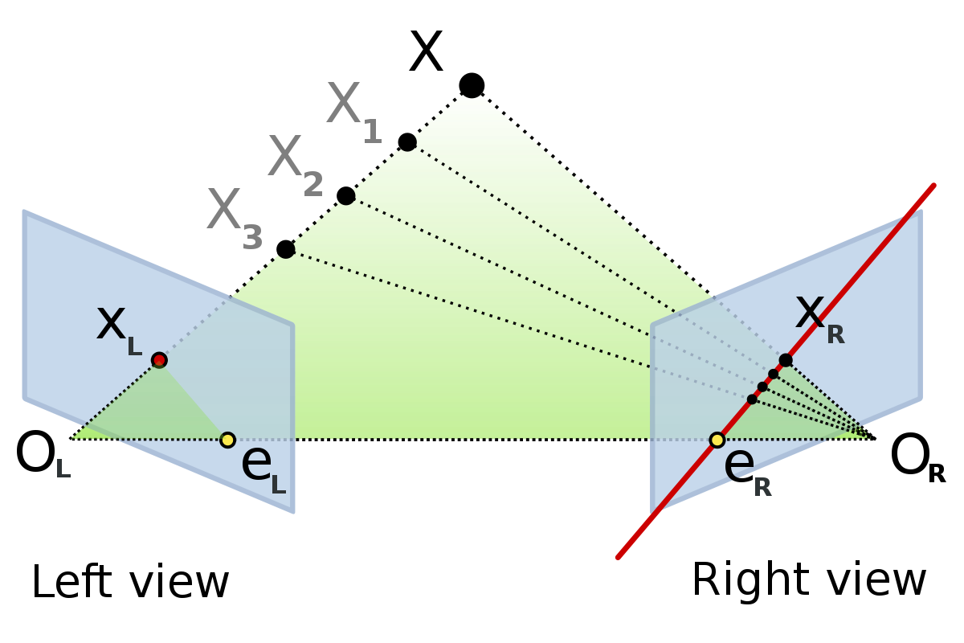
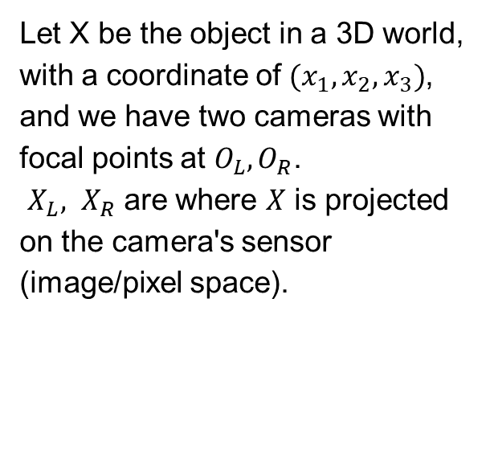
Epipolar geometry
Let X be the object in a 3D world, with a coordinate of $(x_{1},x_{2},x_{3})$, and we have two cameras with focal points at $O_{L},O_{R}$.
$X_{L}, X_{R}$ are where $X$ is projected on the camera's sensor (image/pixel space).

Slide 5
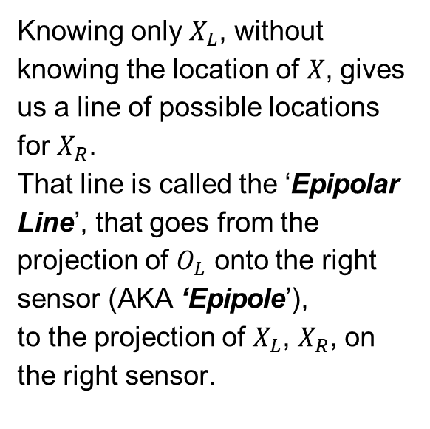
Epipolar geometry
Knowing only $X_{L}$, without knowing the location of $X$, gives us a line of possible locations for $X_{R}$.
That line is called the ‘Epipolar Line’, that goes from the projection of $O_{L}$ onto the right sensor (AKA ‘Epipole’), to the projection of $X_{L}$, $X_{R}$, on the right sensor.

Slide 6

Epipolar geometry
All the points, are on the same plane.
The plane $O_{L}XO_{R}$, which called: ‘Epipolar plane’.

Slide 7
Points and Planes
The green point, projected on the image is at coordinate (x,y), and is defined by Cartesian coordinate system relative to its plane (the image).
If we convert it to homogeneous coordinate system (x,y,1), the point now ‘belongs’ to the projective plane, and is subjected to ‘Projective Geometry’ where only lines and points are invariant.

Slide 8
Points and Planes
A coordinate in the image space (x,y), can be defined by a line in the projective space (sx,sy,s).

Slide 9
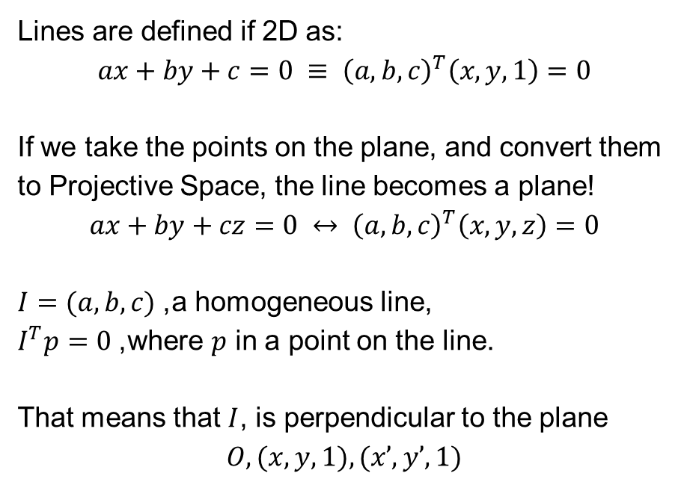
Lines
Lines are defined if 2D as:
$$ax+by+c=0 ≡ {\left(a,b,c\right)}^{T}\left(x,y,1\right)=0$$
If we take the points on the plane, and convert them to Projective Space, the line becomes a plane!
$$ax+by+cz=0 ↔ {\left(a,b,c\right)}^{T}\left(x,y,z\right)=0$$
$I=(a,b,c)$, a homogeneous line, $I^{T}p=0$, where $p$ in a point on the line.
That means that $I$, is perpendicular to the plane
$$O,(x,y,1),(x’,y’,1)$$

Slide 10
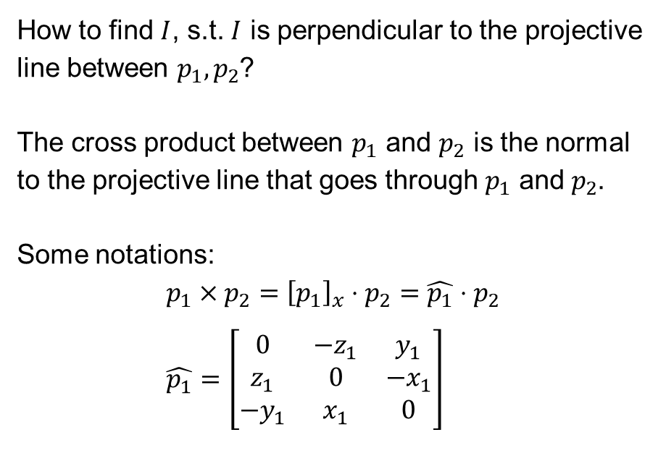
Lines
How to find $I$, s.t. $I$ is perpendicular to the projective line between $p_{1},p_{2}$?
The cross product between $p_{1}$ and $p_{2}$ is the normal to the projective line that goes through $p_{1}$ and $p_{2}$.
Some notations: $$p_{1}×p_{2}={\left[p_{1}\right]}_{x}⋅p_{2}=\hat{p_{1}}⋅p_{2} \\ \hat{p_{1}}=\left[\begin{matrix}0 & −z_{1} & y_{1} \\ z_{1} & 0 & −x_{1} \\ −y_{1} & x_{1} & 0\end{matrix}\right]$$

Slide 11
Essential Matrix

Slide 12
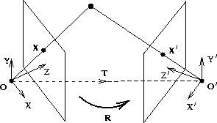
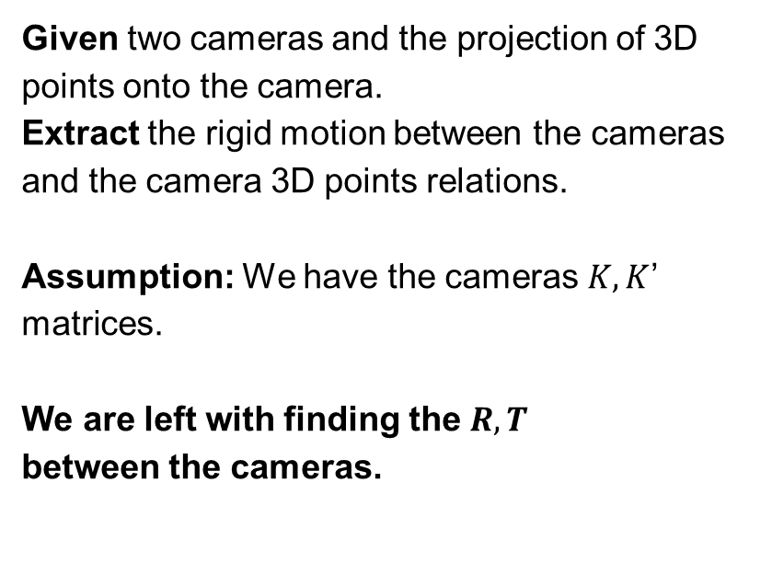
Problem setup
Given two cameras and the projection of 3D points onto the camera.
Extract the rigid motion between the cameras and the camera 3D points relations.
Assumption: We have the cameras $K,K$’ matrices.
We are left with finding the $R,T$ between the cameras.

Slide 13
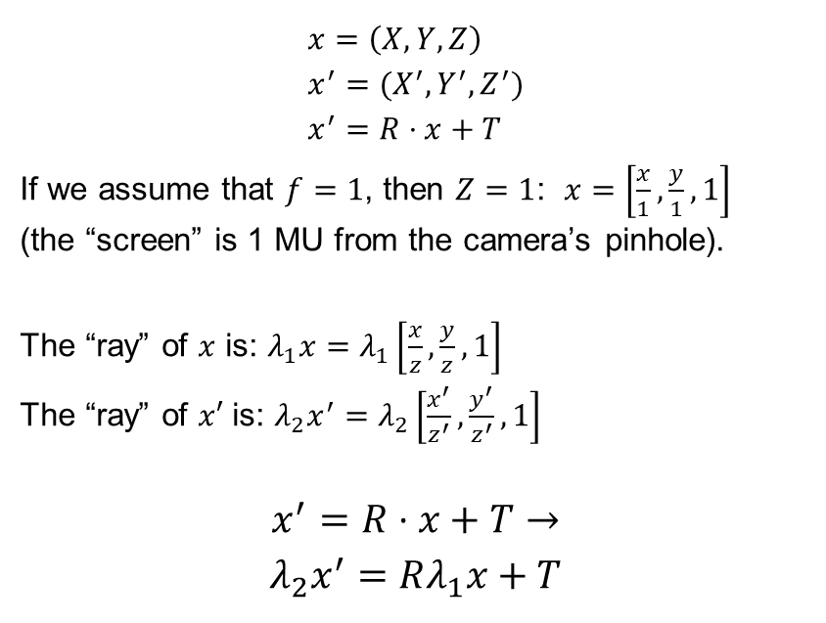
Problem setup
$$x=\left(X,Y,Z\right) \\ x^{′}=(X^{′},Y^{′},Z^{′}) \\ x^{′}=R⋅x+T$$
If we assume that $f=1$, then $Z=1$: $x=\left[\frac{x}{1},\frac{y}{1},1\right]$ (the “screen” is 1 MU from the camera’s pinhole).
The “ray” of $x$ is: $λ_{1}x=λ_{1}\left[\frac{x}{z},\frac{y}{z},1\right]$ The “ray” of $x′$ is: $λ_{2}x^{′}=λ_{2}\left[\frac{x^{′}}{z^{′}},\frac{y^{′}}{z^{′}},1\right]$ $$x^{′}=R⋅x+T→$$
$$λ_{2}x^{′}=Rλ_{1}x+T$$

Slide 14
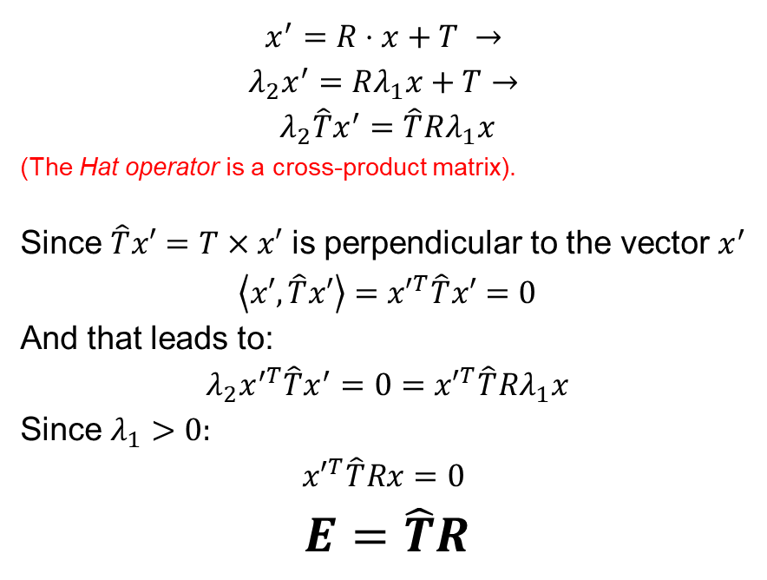
Problem setup
$$x^{′}=R⋅x+T →$$
$$λ_{2}x^{′}=Rλ_{1}x+T→$$
$$λ_{2}\hat{T}x^{′}=\hat{T}Rλ_{1}x$$
(The Hat operator is a cross-product matrix). Since $\hat{T}x′=T×x′$ is perpendicular to the vector $x^{′}$
$$\left\langle x′,\hat{T}x′\right\rangle ={x′}^{T}\hat{T}x′=0$$
And that leads to:
$$λ_{2}x^{′T}\hat{T}x^{′}=0={x′}^{T}\hat{T}Rλ_{1}x$$
Since $λ_{1}>0:$ $${x′}^{T}\hat{T}Rx=0$$
$$E=\hat{T}R$$

Slide 15

Finding the E matrix
$$0={x′}^{T}\hat{T}Rλ_{1}x$$
$$a_{3x3}=x×x^{′} \\ {{(a}_{1x9})}^{T}={\left[xx^{′},xy^{′},xz^{′},yx^{′},yy^{′},yz^{′},zx^{′},zy^{′},zz^{′}\right]}^{T} \\ E_{1x9}=\left[e_{1},e_{4},e_{7},e_{2},e_{5},e_{8},e_{3},e_{6},e_{9}\right]$$
Rewrite $a^{T}E=0$
$$A=\left[\begin{aligned}a_{1}^{T} \\ a_{2}^{T} \\ ⋮ \\ a_{n}^{T}\end{aligned}\right], \min_{E}\left|\left|A⋅E\right|\right|$$

Slide 16

Finding the E matrix
$$Solve using Least Squares:$$
$$\min_{E}\left|\left|A⋅E\right|\right|$$
$$Project the solution:$$
$$SVD\left(E\right)=AΣB^{T}$$
$$Σ^{′}=diag\left(1,1,0\right)$$
$$E=AΣ^{′}B^{T}$$

Slide 17
Fundamental Matrix

Slide 18
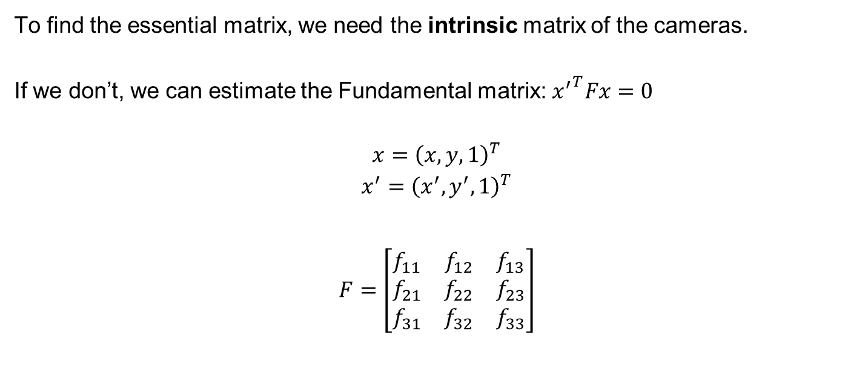
Finding the F matrix
To find the essential matrix, we need the intrinsic matrix of the cameras.
If we don’t, we can estimate the Fundamental matrix:${x^{′}}^{T}Fx=0$
$$x={\left(x,y,1\right)}^{T}$$
$$x^{′}={\left(x^{′},y^{′},1\right)}^{T}$$
$$F=\left[\begin{matrix}f_{11} & f_{12} & f_{13} \\ f_{21} & f_{22} & f_{23} \\ f_{31} & f_{32} & f_{33}\end{matrix}\right]$$

Slide 19
Essential vs. Fundamental
Terminology – epi-polar geometry: F: un-calibrated E: calibrated
Need to know: F: Matching points E: Matching points + Intrinsic Camera Parameters
Minimal Solution: F: 8 points (actually 7) E: 5 points
Solvers: F: RANSAC + DLT + Nonlinear E: RANSAC + Polynomials
What we get: F: for each point its corresponding line, estimated camera matrices P,P’ E: for each point its corresponding line + R + T (we already know K)

